Slide 1

MyHome
Real Estate
By :
1602-19-737-127 Anurag Sahu
1602-19-737-167 B. Shailendhar
1602-19-737-317 B. Vikas

Slide 2
Problem Statement
Problem Statement
In Current System, customer requires to find homes manually or should visit House rental company or should approach a Real Estate agent for buying a house or for renting a house, which is tiresome and wastes alot of time. In existing system customers aren't allowed to rent a house without physically contacting the house owner. In the current system we don't get any details of house specifications unless we visit the home. It is difficult for house owners to sell their properties manually, as it takes lot of time.

Slide 3
Problem Statement
Objective
Main Objective:
The main Objective of this project is to develop an online Real Estate website that allows users to buy and sell their properties, to rent a house without contacting a Rental Company or Estate agent.
Specific Objectives:
To analyze the manual system of Real Estate, outline it’s flaws and provide better solutions.
To study and analyze requirement specifications of online Real Estate Services that allows to buy, sell, and rent residential and commercial properties .

Slide 4
Problem Statement
Abstract
The project purpose is to search homes online to buy or for rent and post properties to sell or for rent . This web application helps users to search homes in desired location based on their requirements and house specifications.
The application provides complete information about available homes with details of rent cost, address, BHK, availability of vehicle parking, floor, facing, area, status and nearby landmarks through maps.
The application has a special feature, where users can interact with the existing members of their society through chat. For every society, a separate blog will be available where the user can get information related to things currently happening in the society.
With this application, a normal user can search homes to buy or rent and a registered user can have access to contact house owner through mail. Property owner can be able to post details of his property. Using this site, users can also book visit for a site visit.
This application helps customers in filtering rental homes based on their budget, house specifications, facing, locality and availability of vehicle parking.

Slide 5



Problem Statement
Actors
User
Owner
Admin

Slide 6
Problem Statement
Use Cases
User
Owner
Admin
Register
Login
View Properties
Search Properties
Book for site visit
Shortlist
View location on map
chat with neighbours
Register
Login
Post Property Details
Edit property details
Delete property
Get Inquiries
Login
Add/Edit/Delete property details
Property verification

Slide 7
Problem Statement
Extended Use Cases
Maps feature : Each property has maps feature which helps users to see the nearby places in map. It helps user to see where exactly the property is located, to view nearby schools, park etc.
Interact with Society : User can chat with members of society.
Book for a Site Visit : User can make a site visit.
House Price Prediction : User can predict house price by selecting attributes like locality, bhk, area etc.
Mail Enquiry : User can inquire about a property through email.

Slide 8
Problem Statement
Tech Stack
Frontend :
HTML
CSS
Bootstrap
JavaScript
Backend :
Python
Postgre SQL
Framework :
Django

Slide 9
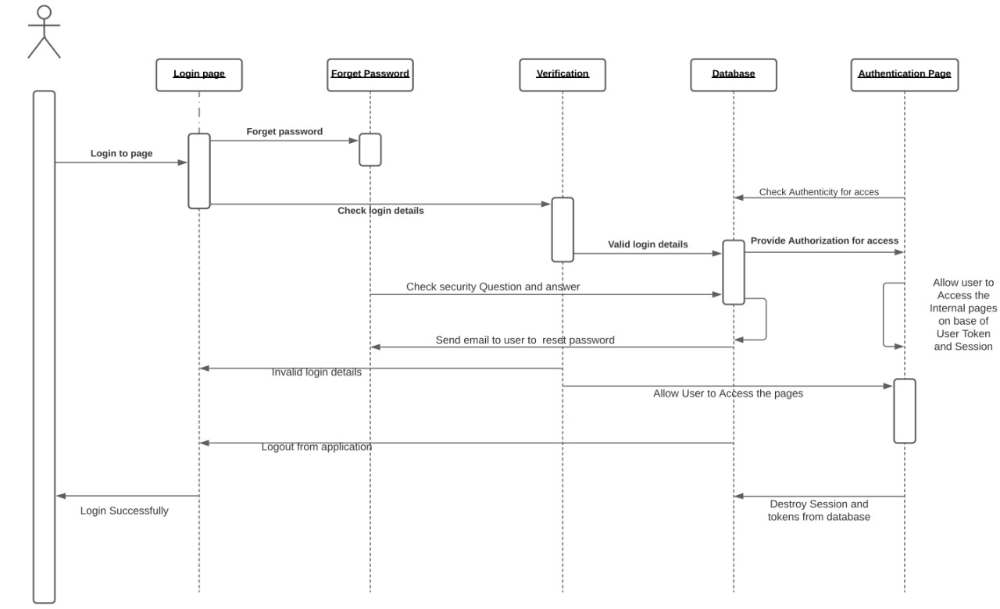
Problem Statement
SEQUENCE DIAGRAM

Slide 10
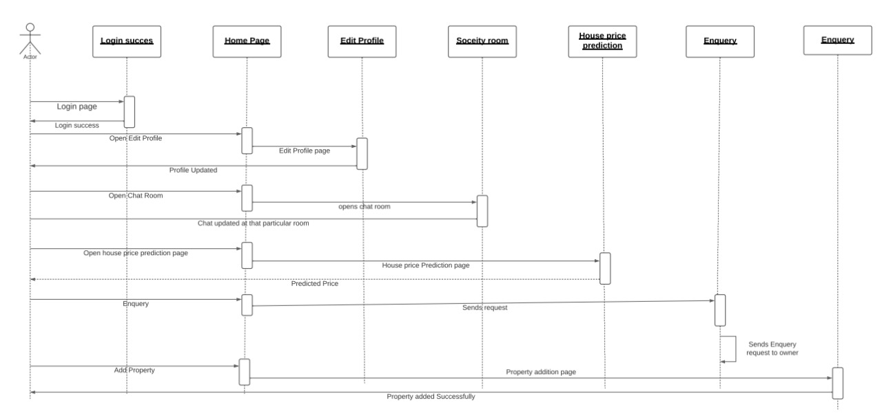
Problem Statement
SEQUENCE DIAGRAM

Slide 11
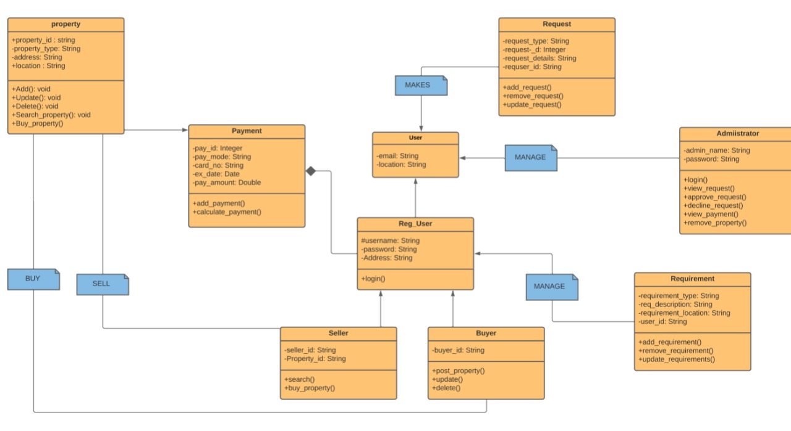
Problem Statement
CLASS DIAGRAM

Slide 12
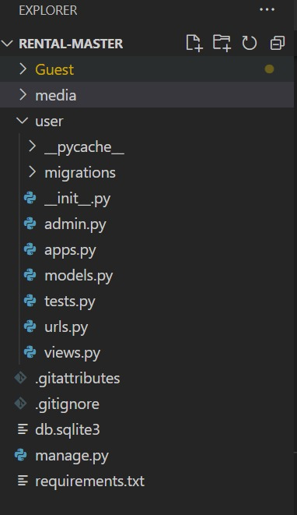
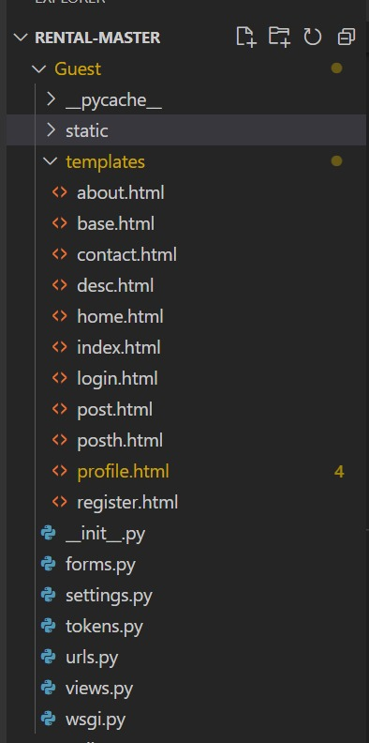
Problem Statement
DIRECTORY STRUCTURE

Slide 13
IMPLEMENTATION

Slide 14
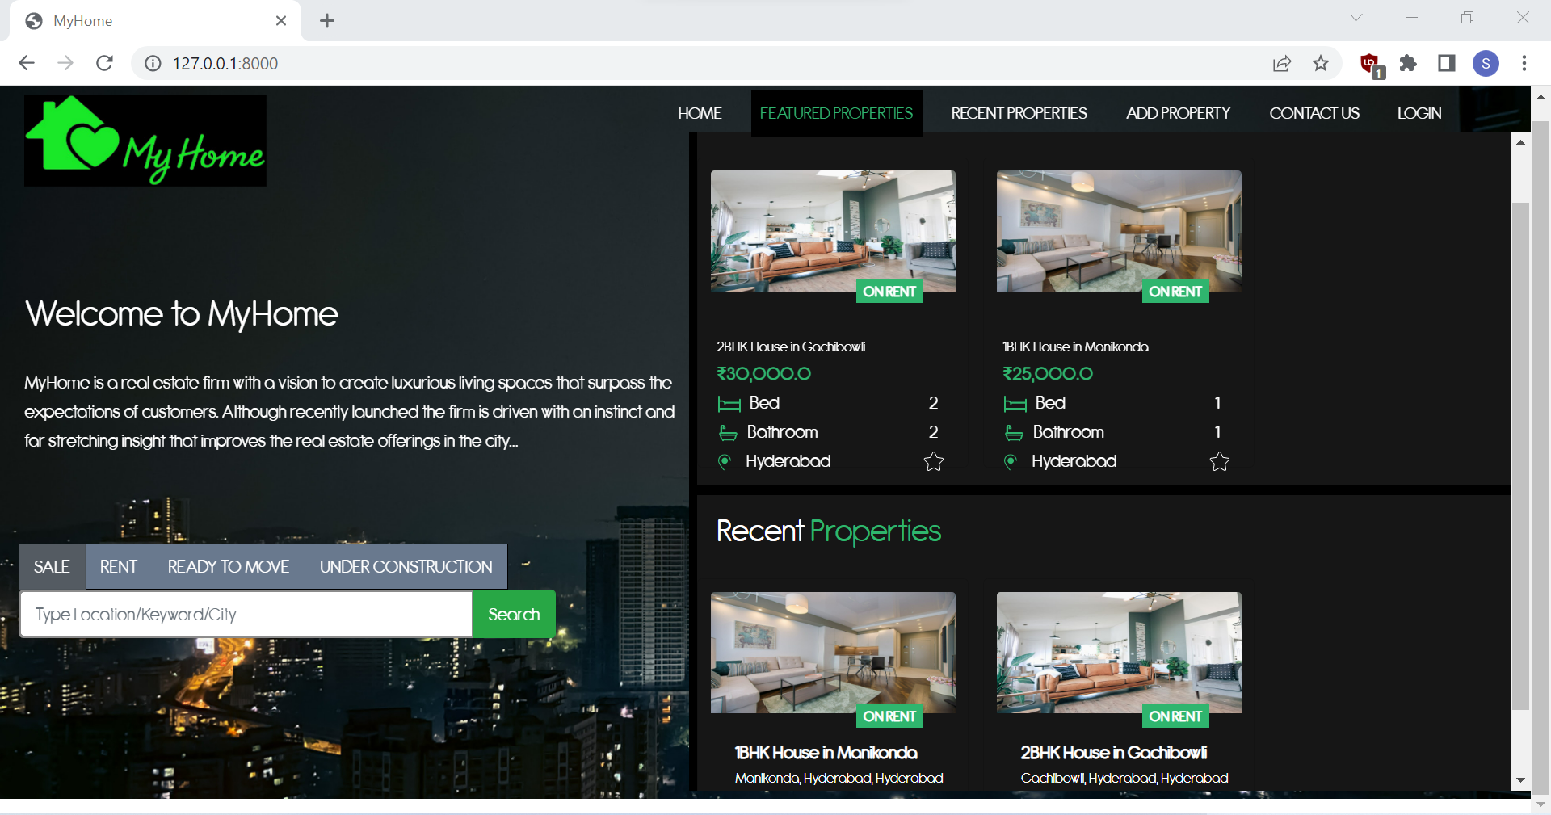
HOMEPAGE

Slide 15
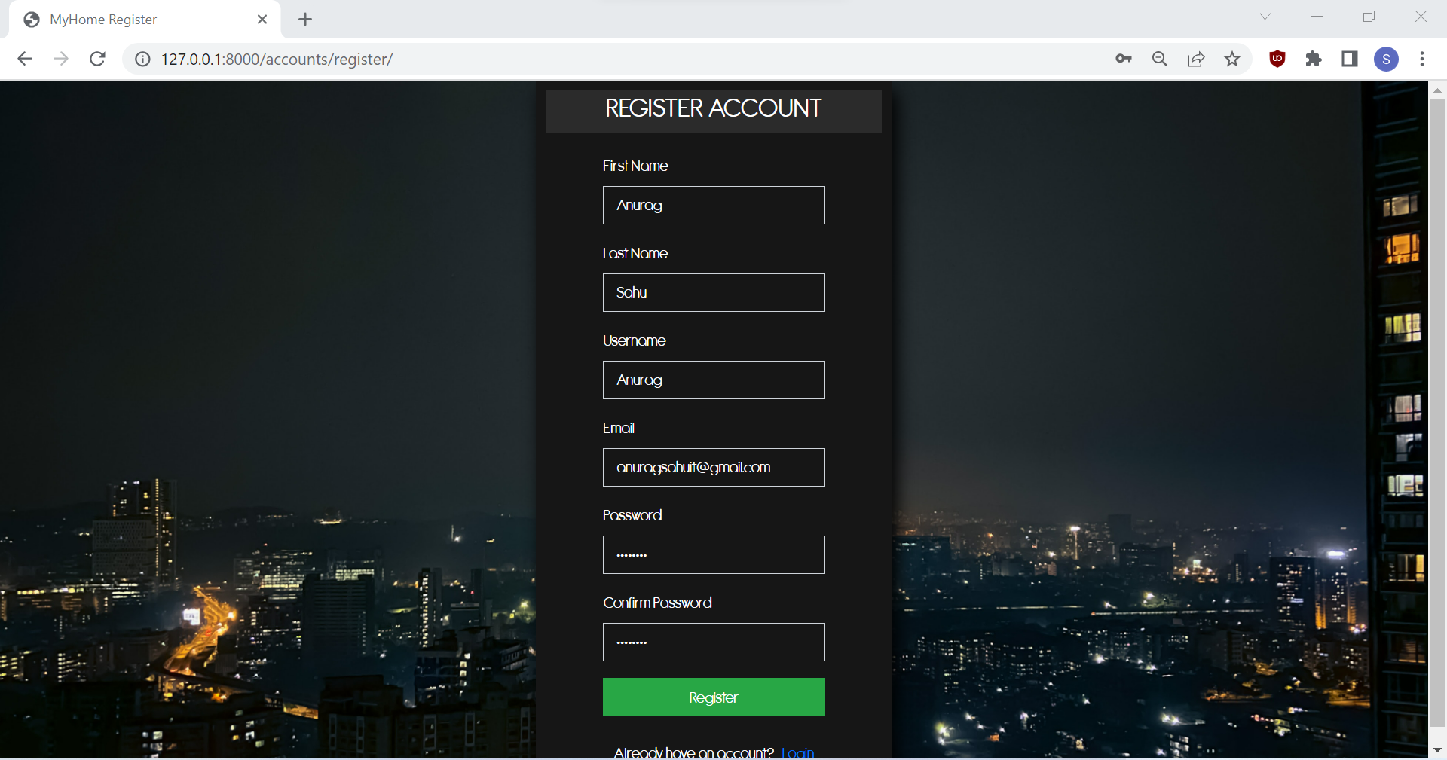
REGISTER

Slide 16
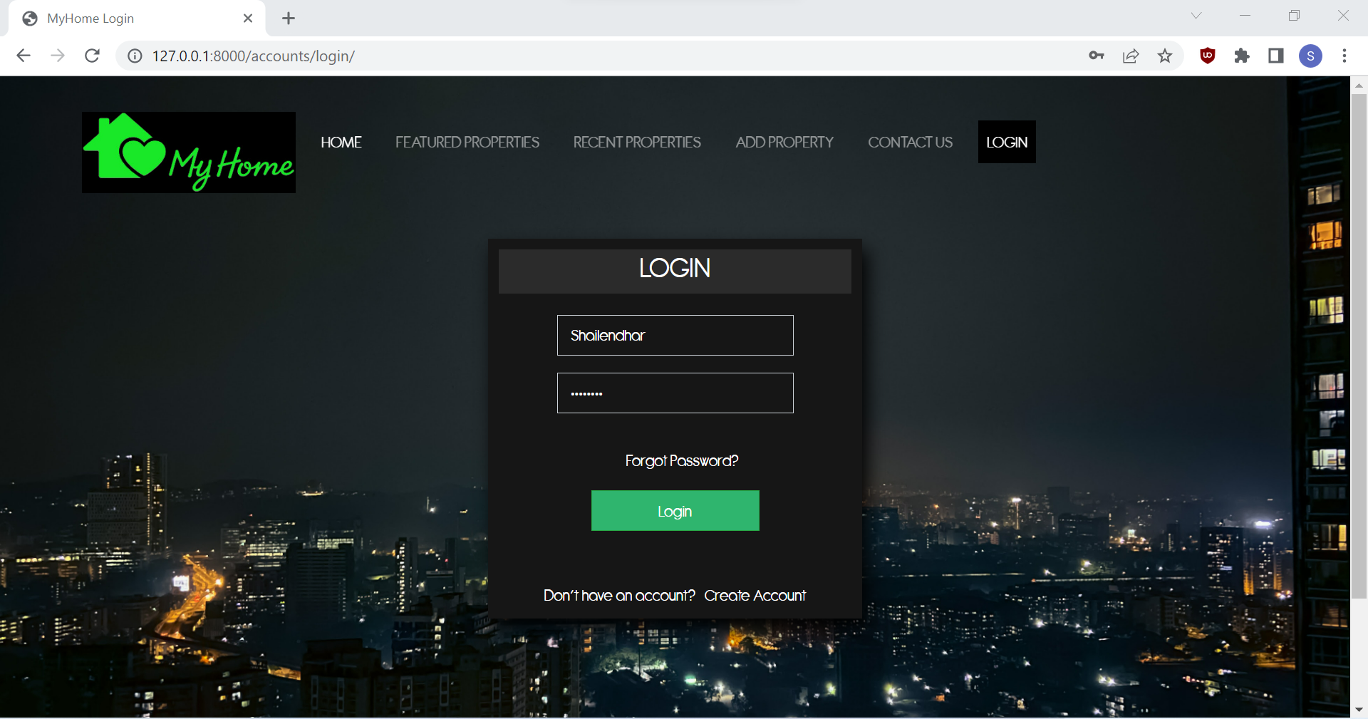
LOGIN

Slide 17
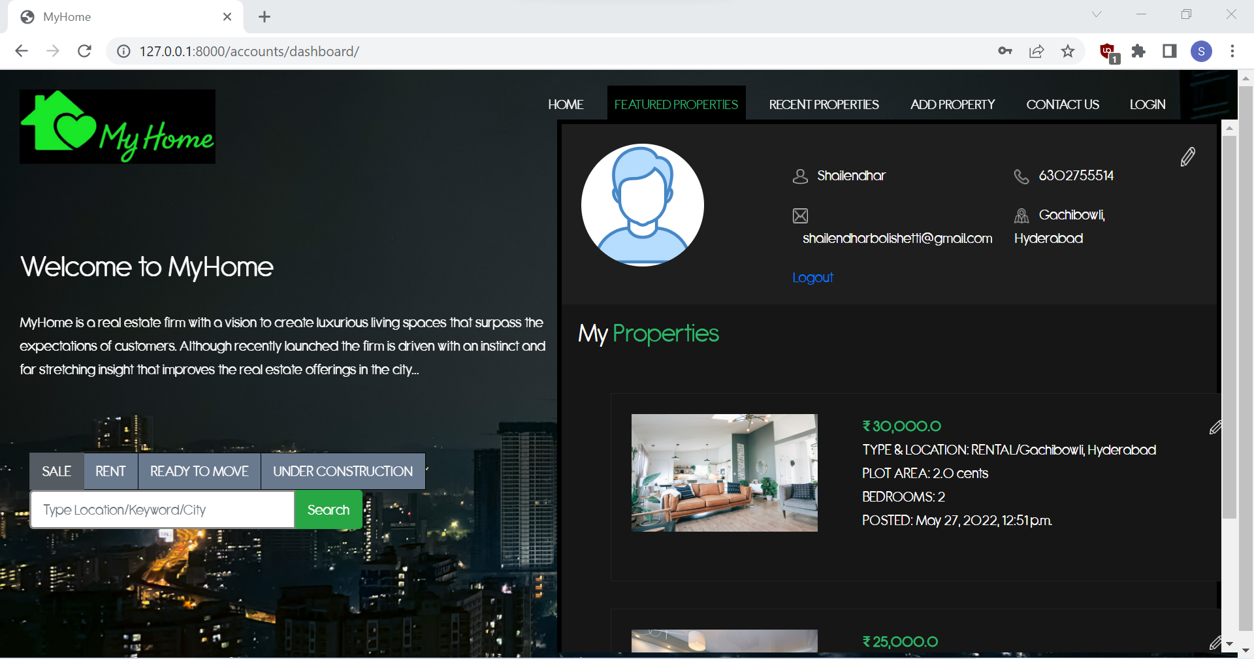
DASHBOARD

Slide 18
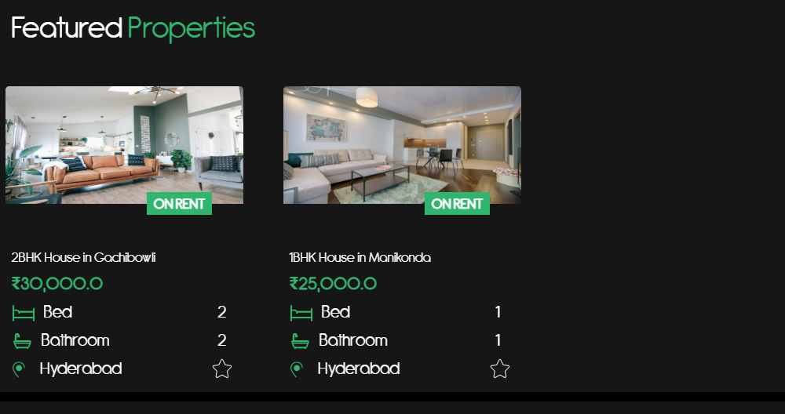
FEATURED PROPERTIES

Slide 19
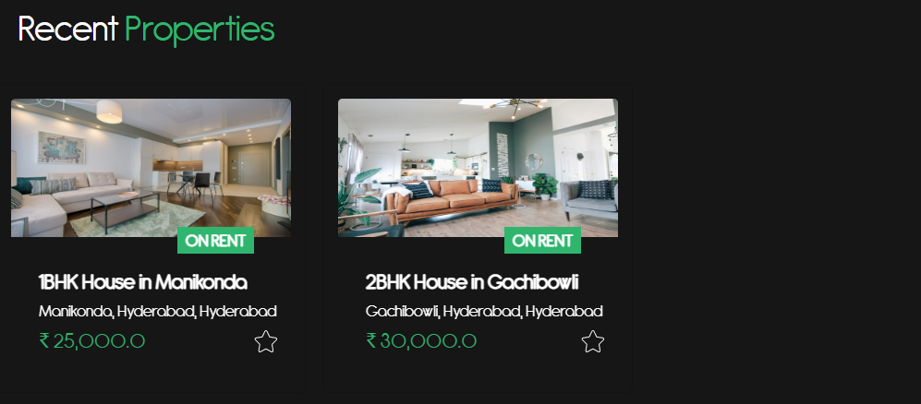
FEATURED PROPERTIES

Slide 20
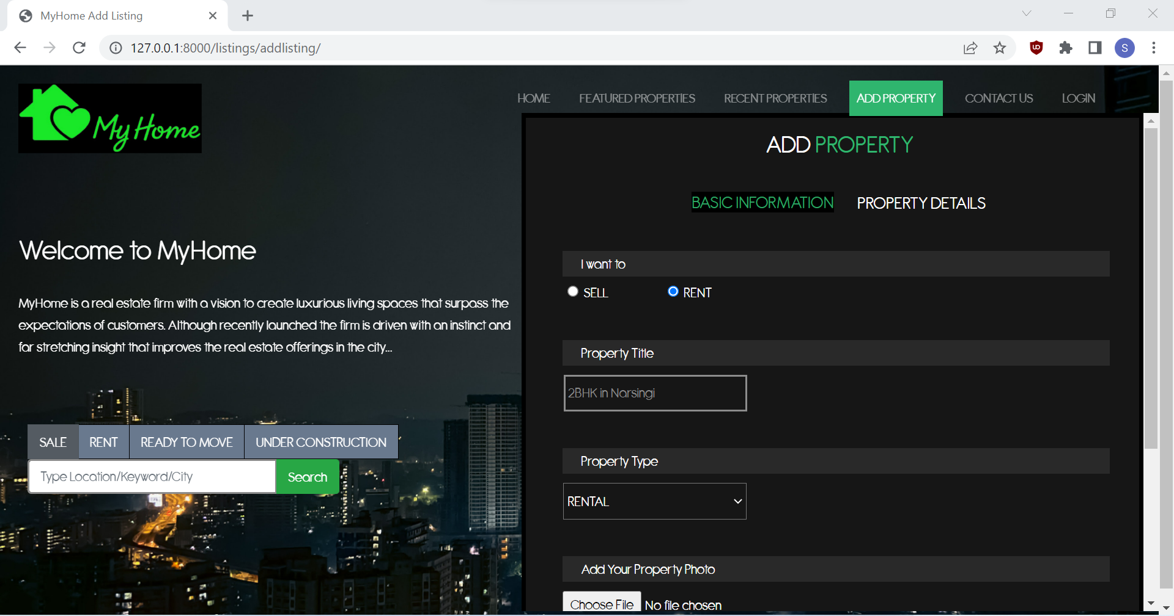
ADD PROPERTY

Slide 21
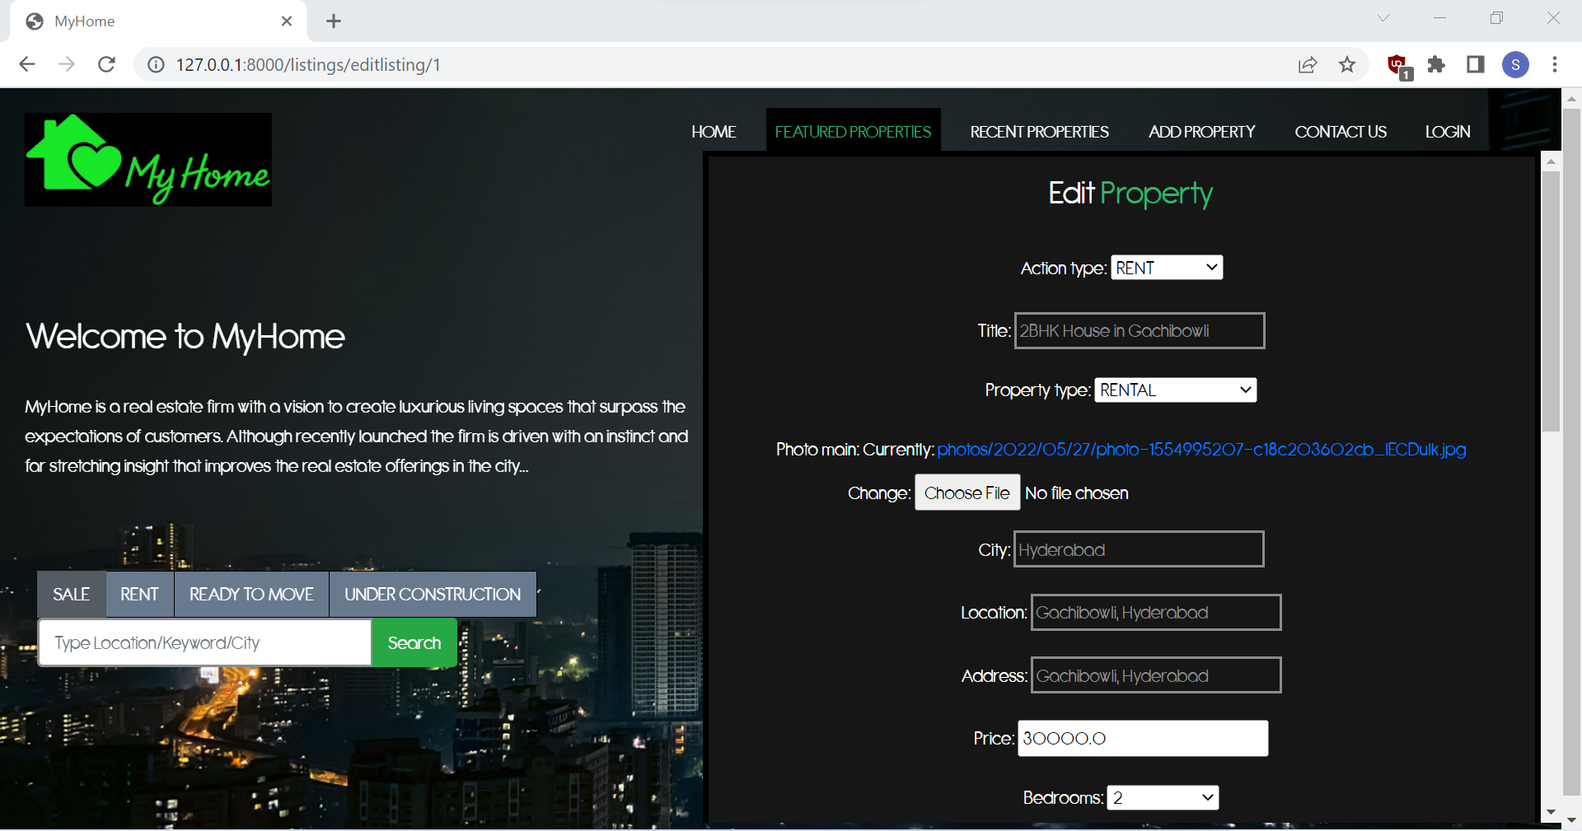
EDIT PROPERTY

Slide 22
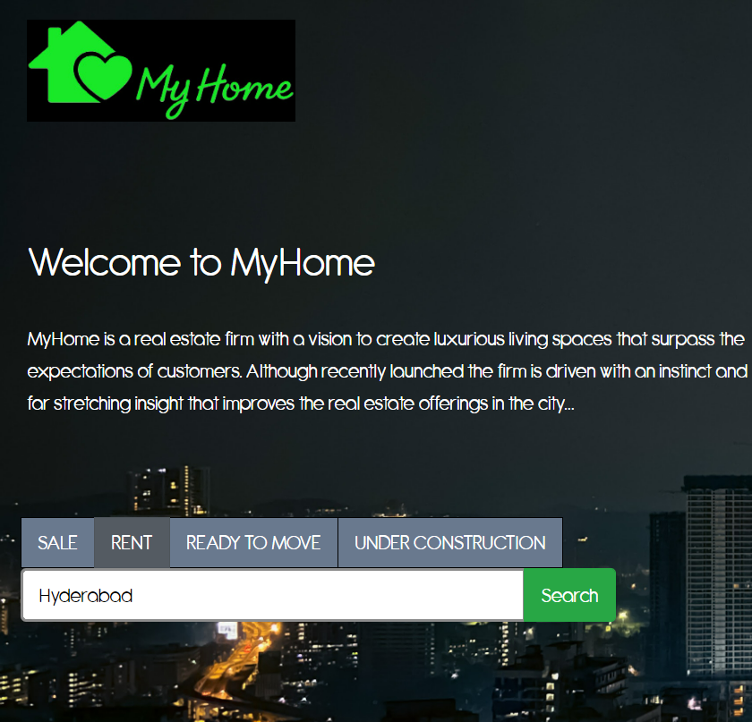
SEARCH PROPERTY

Slide 23
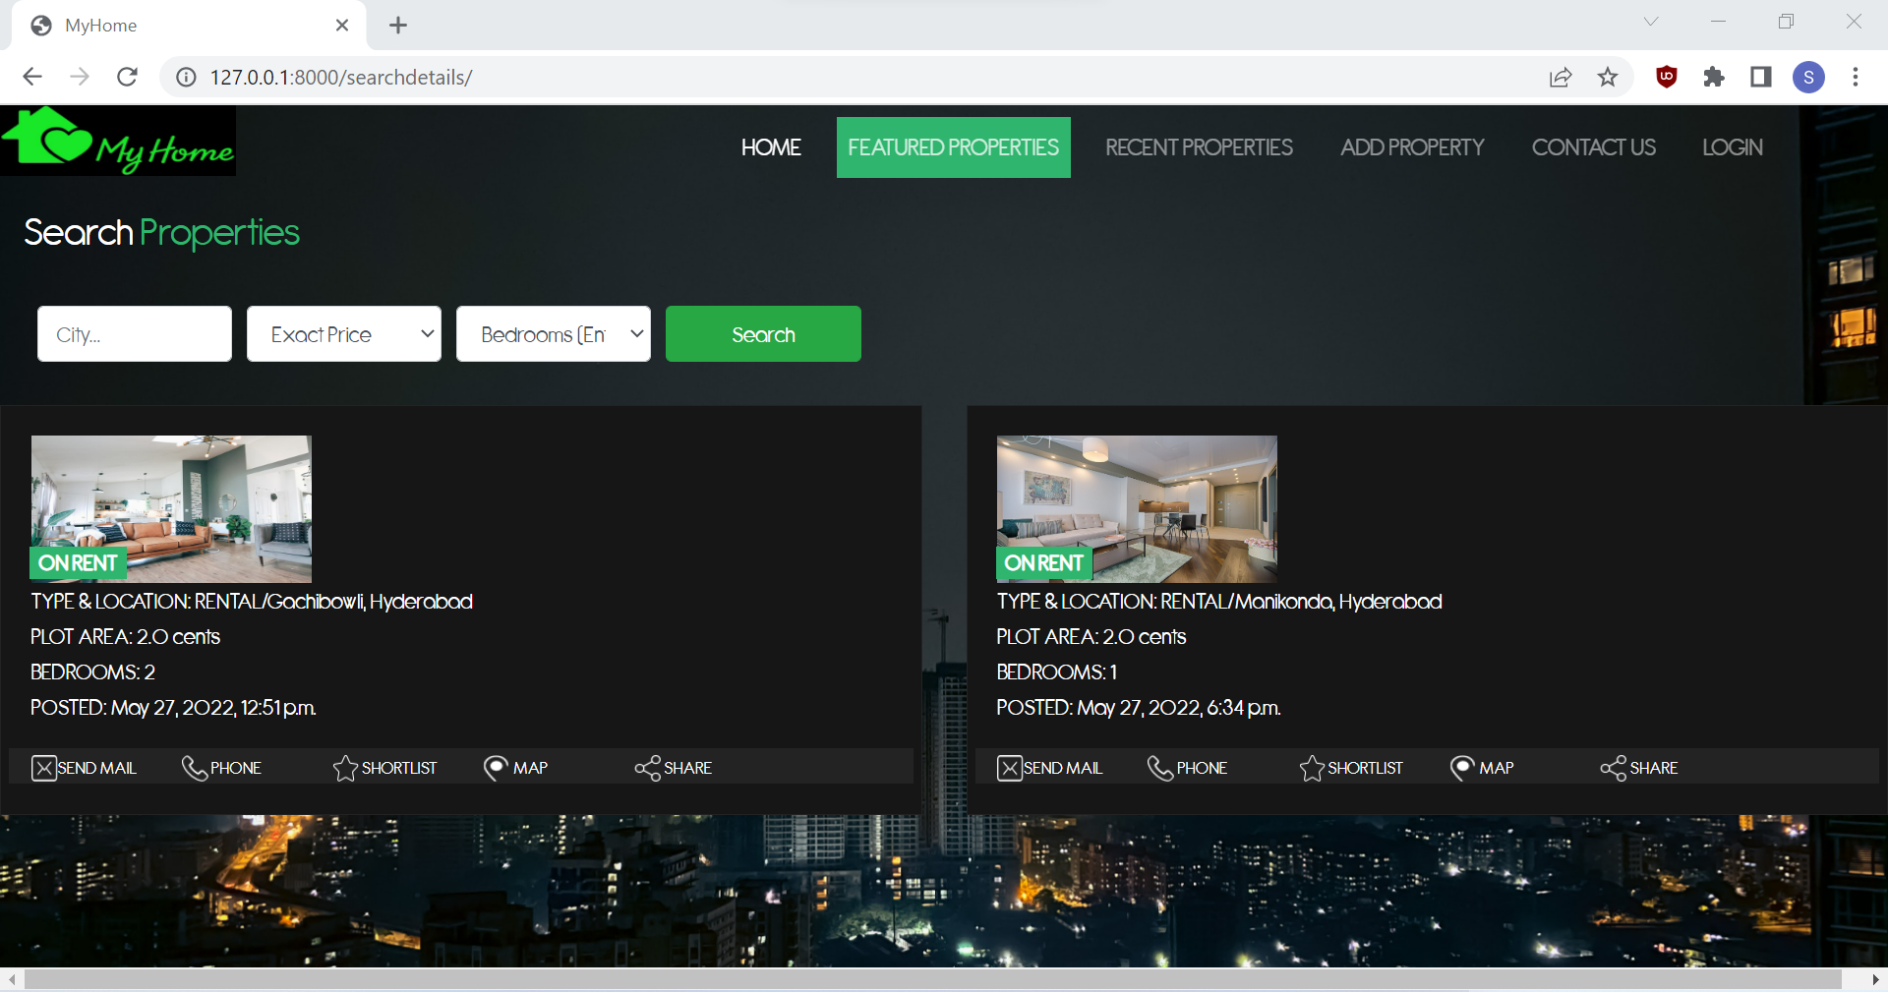
SEARCH PROPERTY

Slide 24
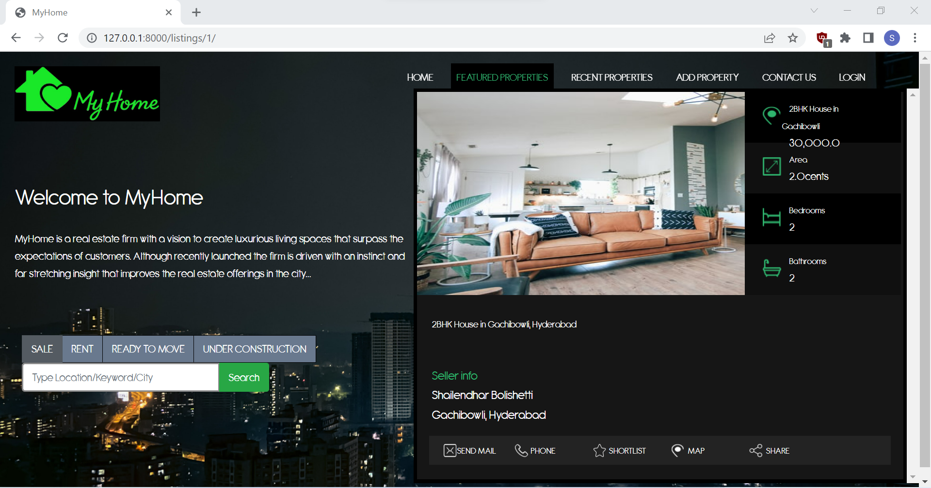
PROPERTY DETAILS

Slide 25
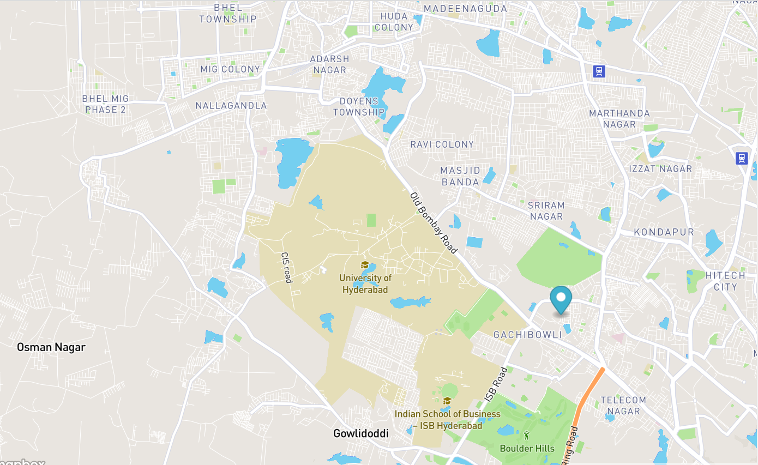
MAP FEATURE

Slide 26
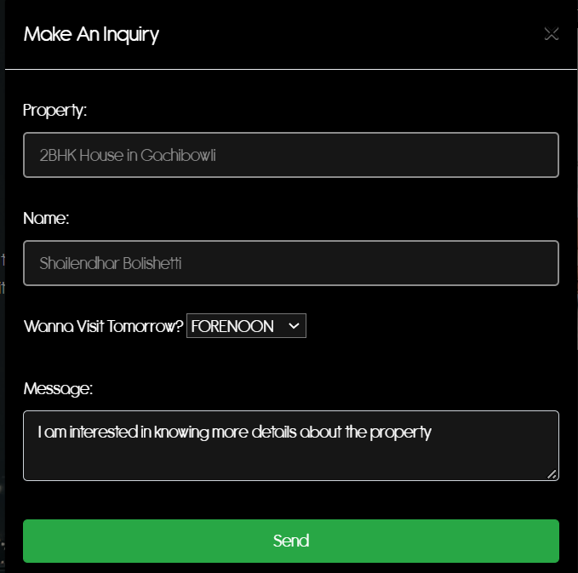
MAKE AN INQUIRY

Slide 27
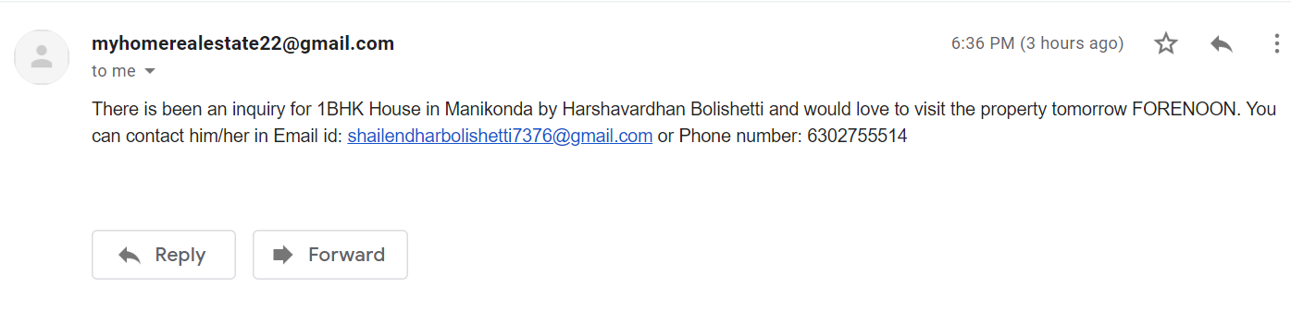
INQUIRY THROUGH MAIL

Slide 28
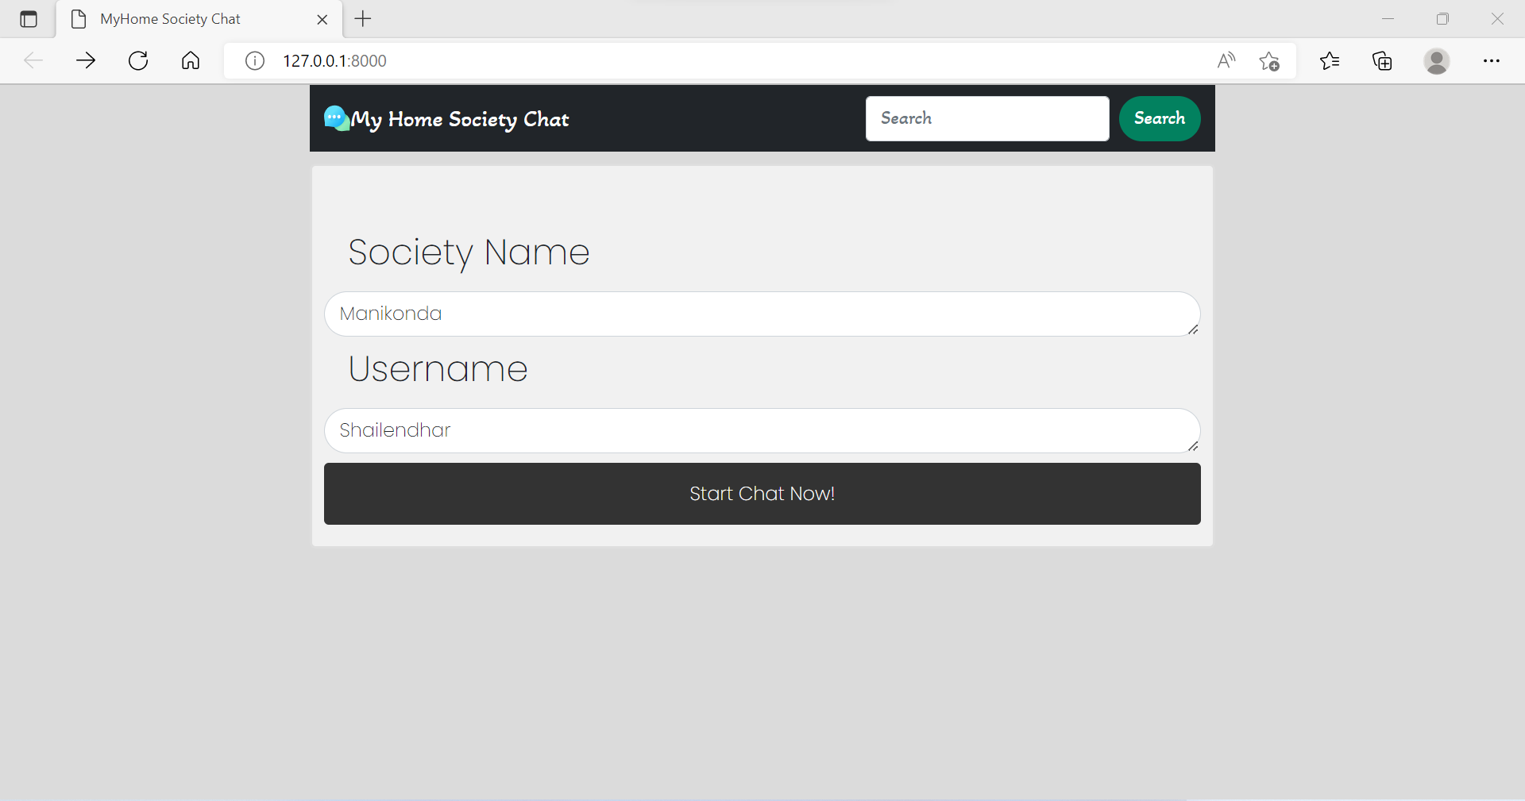
CHAT FEATURE

Slide 29
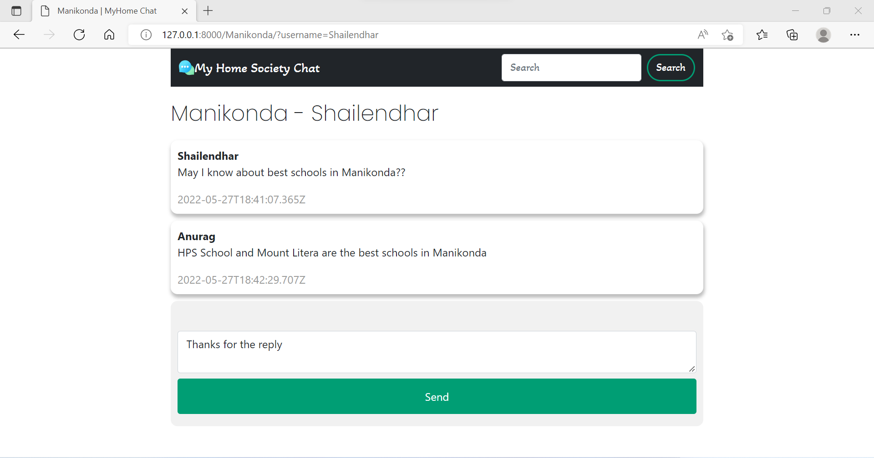
CHAT FEATURE

Slide 30
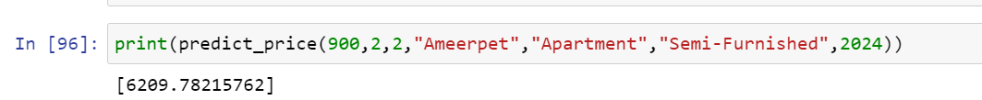
RENT & HOUSE PRICE PREDICTION

Slide 31
Problem Statement
CONCLUSION
We have successfully developed a secure, user-friendly web application. This system is capable of searching properties, posting ads of properties for rent and sale. It uses a client/server architecture based on the HTTP protocol. It is developed in Microsoft’s Visual Studio. The buyer performs a search for the property listings by putting either City/location in the search textbox. The user can view the property location in map. User can also inquire about a property through mail. User can also interact with members of society in order to resolve his queries. This system will definitely reduce the time to search for a house to have it for rent or to buy by having all the properties online.

Slide 32
Problem Statement
REFERENCES
https://youtube/cdPcTuazI/
https://youtube/1BeZxMbSZNI/ https://stackoverflow.com/questions/57217823/dj https://fontawesome.com/v4.7/icon/star-half-o https://docs.djangoproject.com/en/3.2/ref/models/querysets/ https://www.webforefront.com/django/usebuiltinjinjastatements.html

Slide 33
Thank You…

